Slide 1
Computer Organization Principles
School of Software, Dalian University of Technology
Chi Lin (林驰)
chilin@mail.dlut.edu.cn

Slide 2
Great Reality #4: Memory Matters Random Access Memory Is an Unphysical Abstraction
Carnegie Mellon
Memory is not unbounded
It must be allocated and managed
Many applications are memory dominated
Memory referencing bugs especially pernicious(致命的)
Effects are distant in both time and space
Memory performance is not uniform
Cache and virtual memory effects can greatly affect program performance
Adapting program to characteristics of memory system can lead to major speed improvements

Slide 3
Memory System Performance Example
Carnegie Mellon
void copyij(int src[2048][2048],
int dst[2048][2048])
{
int i,j;
for (i = 0; i < 2048; i++)
for (j = 0; j < 2048; j++)
dst[i][j] = src[i][j];
}
void copyji(int src[2048][2048],
int dst[2048][2048])
{
int i,j;
for (j = 0; j < 2048; j++)
for (i = 0; i < 2048; i++)
dst[i][j] = src[i][j];
}
21 times slower (Pentium 4)
Hierarchical memory organization
Performance depends on access patterns
Including how step through multi-dimensional array

Slide 4
The Memory Mountain
Carnegie Mellon
Intel Core i7
2.67 GHz
32 KB L1 d-cache
256 KB L2 cache
8 MB L3 cache

Slide 5
Chapter Six：Memory
6.1 Memory Hierarchy
6.2 Cache
6.3 Virtual Memory

Slide 6
6.1 Memory Hierarchy
Storage technologies and trends
Locality of reference
Caching in the memory hierarchy

Slide 7
6.1 Memory Hierarchy
Storage technologies and trends
Locality of reference
Caching in the memory hierarchy

Slide 8
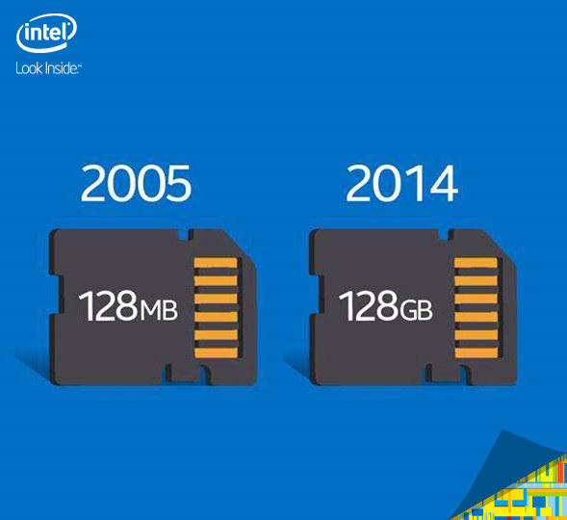
Developing Trends

Slide 9
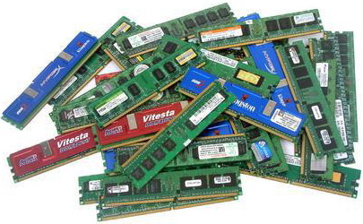
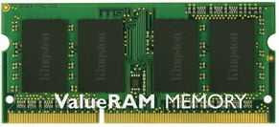
Summary of Memory
Memory dominated applications.
Speed
DMA
Information Exchange

Slide 10
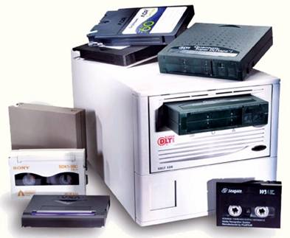
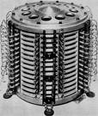
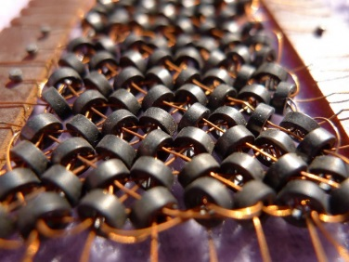
Memory Category
Physical Type
Semiconductor：TTL、MOS
small, low cost, fast, volatile
Magnetic: disk(磁盘), tape(磁带), magnetic drum(磁鼓)
Optical: CD, CD-R, CD-RW, DVD, Blue-ray DVD
volatile
Non-
volatile

Slide 11
Storage Type
Random Access Memory
Volatile
SRAM(Cache), DRAM(内存)
Read Only Memory
Non-volatile
掩膜型只读存储器（ROM）、可编程只读存储器（PROM）、可擦除可编程只读存储器（EPROM）、电可擦除可编程只读存储器（EEPROM）、闪速存储器（Flash Memory）
Notes:
ROM指的是“只读存储器”，即Read-Only Memory。这是一种线路最简单半导体电路，通过掩模工艺， 一次性制造，其中的代码与数据将永久保存(除非坏掉)，不能进行修改。这玩意一般在大批量生产时才会被用的，优点是成本低、非常低，但是其风险比较大，在产品设计时，如果调试不彻底，很容易造成几千片的费片，行内话叫“掩砸了”！ PROM指的是“可编程只读存储器”既Programmable Red-Only Memory。这样的产品只允许写入一次，所以也被称为“一次可编程只读存储器”(One Time Progarmming ROM，OTP-ROM)。PROM在出厂时，存储的内容全为1，用户可以根据需要将其中的某些单元写入数据0(部分的PROM在出厂时数据全为0，则用户可以将其中的部分单元写入1)， 以实现对其“编程”的目的。PROM的典型产品是“双极性熔丝结构”，如果我们想改写某些单元，则可以给这些单元通以足够大的电流，并维持一定的时间，原先的熔丝即可熔断，这样就达到了改写某些位的效果。另外一类经典的PROM为使用“肖特基二极管”的PROM，出厂时，其中的二极管处于反向截止状态，还是用大电流的方法将反相电压加在“肖特基二极管”，造成其永久性击穿即可。 EPROM指的是“可擦写可编程只读存储器”，即Erasable Programmable Read-Only Memory。 它的特点是具有可擦除功能，擦除后即可进行再编程，但是缺点是擦除需要使用紫外线照射一定的时间。这一类芯片特别容易识别，其封装中包含有“石英玻璃窗”，一个编程后的EPROM芯片的“石英玻璃窗”一般使用黑色不干胶纸盖住， 以防止遭到阳光直射。 EEPROM指的是“电可擦除可编程只读存储器”，即Electrically Erasable Programmable Read-Only Memory。它的最大优点是可直接用电信号擦除，也可用电信号写入。EEPROM不能取代RAM的原应是其工艺复杂， 耗费的门电路过多，且重编程时间比较长，同时其有效重编程次数也比较低。 Flash memory指的是“闪存”，所谓“闪存”，它也是一种非易失性的内存，属于EEPROM的改进产品。它的最大特点是必须按块(Block)擦除(每个区块的大小不定，不同厂家的产品有不同的规格)， 而EEPROM则可以一次只擦除一个字节(Byte)。目前“闪存”被广泛用在PC机的主板上，用来保存BIOS程序，便于进行程序的升级。其另外一大应用领域是用来作为硬盘的替代品，具有抗震、速度快、无噪声、耗电低的优点，但是将其用来取代RAM就显得不合适，因为RAM需要能够按字节改写，而Flash ROM做不到。

Slide 12
ROM
Read-only memory (ROM) is a class of storage medium used in computers and other electronic devices.
Strictly, read-only memory refers to memory that is hard-wired, such as diode matrix and the later mask ROM.
The fact that such memory can never be changed is a large drawback; more recently, ROM commonly refers to memory that is read-only in normal operation.

Slide 13
PROM
A programmable read-only memory (PROM) is a form of digital memory where the setting of each bit is locked by a fuse or antifuse.
They are a type of ROM (read-only memory) meaning the data in them is permanent and cannot be changed. PROMs are used in digital electronic devices to store permanent data, usually low level programs such as firmware (microcode).
The key difference from a standard ROM is that the data is written into a ROM during manufacture, while with a PROM the data is programmed into them after manufacture.
Notes:
1.一次编程只读存储器（ROM） 可编程只读存储器只允许写入一次，所以也被称为“一次可编程只读存储器”(One Time Progarmming ROM，OTP-ROM)。PROM在出厂时，存储的内容全为1，用户可以根据需要将其中的某些单元写入数据0(部分的PROM在出厂时数据全为0，则用户可以将其中的部分单元写入1)， 以实现对其“编程”的目的。PROM的典型产品是“双极性熔丝结构”，如果我们想改写某些单元，则可以给这些单元通以足够大的电流，并维持一定的时间，原先的熔丝即可熔断，这样就达到了改写某些位的效果。另外一类经典的PROM为使用“肖特基二极管”的PROM，出厂时，其中的二极管处于反向截止状态，还是用大电流的方法将反相电压加在“肖特基二极管”，造成其永久性击穿即可。

Slide 14
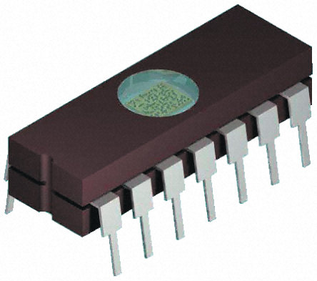
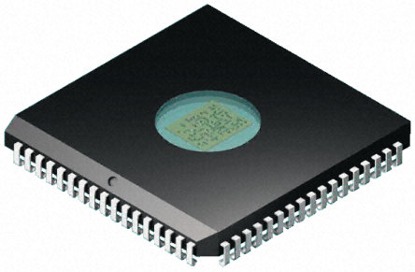
EPROM
Once programmed, an EPROM can be erased by exposing it to strong ultraviolet light source (such as from a mercury-vapor light)
紫外线接收窗

Slide 15
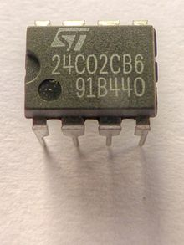
EEPROM
EEPROM stands for Electrically Erasable Programmable Read-Only Memory and is a type of non-volatile memory used in computers and other electronic devices to store small amounts of data that must be saved when power is removed.

Slide 16

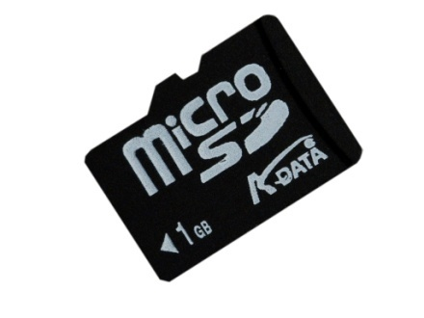


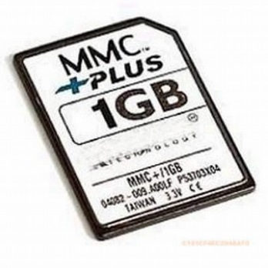
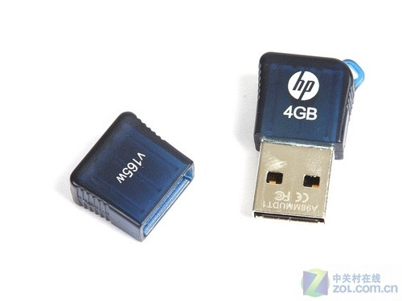


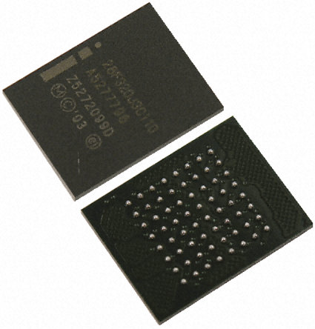
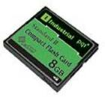
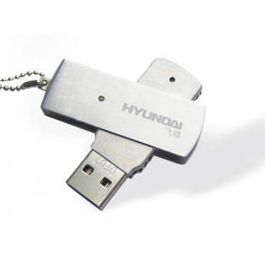

FLASH

Slide 17
FLASH vs EEPROM, RAM
FLASH vs EEPROM
Fast Reading & Writing
Large Capacity
FLASH vs RAM
Non-volitile

Slide 18
Summary of Memory
DRAM
RAM
SRAM
Main Memory
MROM
PROM
ROM
EPROM
Memory
EEPROM
Flash Memory
Cache
External Memory
Disk, CD, DVD…

Slide 19
Random-Access Memory (RAM)
Key features
RAM is traditionally packaged as a chip.
Basic storage unit is normally a cell (one bit per cell).
Multiple RAM chips form a memory.
Static RAM (SRAM)
Each cell stores a bit with a four or six-transistor circuit (6晶体管电路
Retains value indefinitely, as long as it is kept powered.
Relatively insensitive to electrical noise (EMI), radiation, etc.
Faster and more expensive than DRAM.

Slide 20
Random Access Memory(RAM)
Dynamic RAM (DRAM)
Each cell stores bit with a capacitor(电容). One transistor(晶体管) is used for access
Value must be refreshed(更新、充电) every 10-100 ms.
More sensitive to disturbances (EMI, radiation,…) than SRAM.
Slower and cheaper than SRAM.

Slide 21
SRAM vs DRAM Summary
Trans. Access Needs Needs
per bit time refresh? EDC? Cost Applications
SRAM 4 or 6 1X No Maybe 100x Cache memories
DRAM 1 10X Yes Yes 1X Main memories,
frame buffers

Slide 22
Key Characteristic of Main Memory
Memory Capacity: Number of binary bit in memory
Capacity=Number of storage unit×word

Slide 23
Conventional DRAM Organization
d * w DRAM:
dw total bits organized as d supercells of size w bits
16 x 8 DRAM chip
cols
Memory
controller
0
1
2
3
2 bits
/
0
addr
1
rows
2
supercell
(2,1)
(to/from CPU)
3
8 bits
/
data
Internal row buffer

Slide 24
Reading DRAM Supercell (2,1)
Step 1(a): Row access strobe (RAS) selects row 2.
Step 1(b): Row 2 copied from DRAM array to row buffer.
16 x 8 DRAM chip
Cols
Memory
controller
RAS = 2
0
1
2
3
2
/
0
addr
1
Rows
2
8
/
3
data
Internal row buffer

Slide 25
Reading DRAM Supercell (2,1)
Step 2(a): Column access strobe (CAS) selects column 1.
Step 2(b): Supercell (2,1) copied from buffer to data lines, and eventually back to the CPU.
16 x 8 DRAM chip
Cols
Memory
controller
CAS = 1
0
1
2
3
2
/
0
addr
To CPU
1
Rows
2
supercell
(2,1)
3
8
/
data
supercell
(2,1)
Internal row buffer

Slide 26
Memory Modules
addr (row = i, col = j)
: supercell (i,j)
DRAM 0
64 MB
memory module
consisting of
eight 8Mx8 DRAMs
DRAM 7
bits
56-63
bits
48-55
bits
40-47
bits
32-39
bits
24-31
bits
16-23
bits
8-15
bits
0-7
63
63
56
56
55
55
48
48
47
47
40
40
39
39
32
32
31
31
24
24
23
23
16
16
15
15
8
8
7
7
0
0
Memory
controller
64-bit doubleword at main memory address A
64-bit doubleword

Slide 27
Enhanced DRAMs
Basic DRAM cell has not changed since its invention in 1966.
Commercialized by Intel in 1970.
DRAM cores with better interface logic and faster I/O :
Synchronous DRAM (SDRAM)
Uses a conventional clock signal instead of asynchronous control
Allows reuse of the row addresses (e.g., RAS, CAS, CAS, CAS)

Slide 28
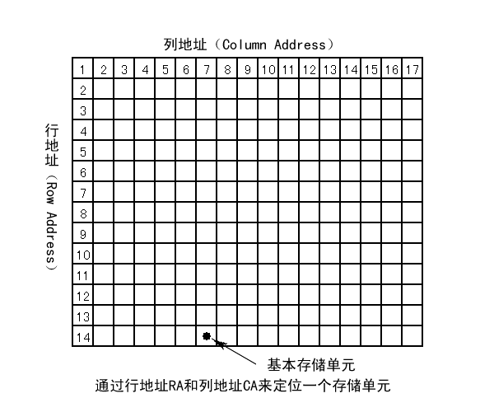
SDRAM

Slide 29
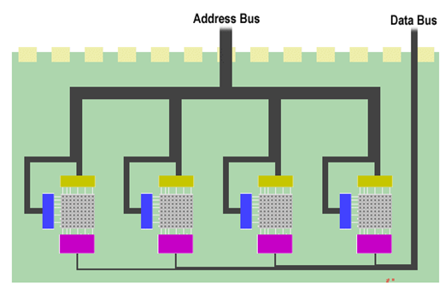
Chip Select（BA0，BA1）

Slide 30
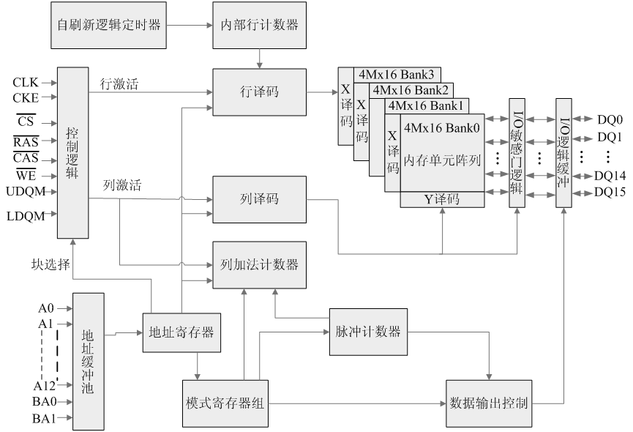
SDRAM

Slide 31
Enhanced DRAMs
Double data-rate synchronous DRAM (DDR SDRAM)
Double edge clocking (双沿时钟) sends two bits per cycle per pin
Different types distinguished by size of small prefetch buffer:
DDR (2 bits), DDR2 (4 bits), DDR4 (8 bits)
By 2010, standard for most server and desktop systems
Intel Core i7 supports only DDR3 SDRAM

Slide 32
Nonvolatile Memories
DRAM and SRAM are volatile memories
Lose information if powered off.
Nonvolatile memories retain value even if powered off
Read-only memory (ROM): programmed during production
Programmable ROM (PROM): can be programmed once
Eraseable PROM (EPROM): can be bulk erased (UV, X-Ray)
Electrically eraseable PROM (EEPROM): electronic erase capability
Flash memory: EEPROMs with partial (sector) erase capability
Wears out after about 100,000 erasings.

Slide 33
Nonvolatile Memories
Uses for Nonvolatile Memories
Firmware programs stored in a ROM (BIOS, controllers for disks, network cards, graphics accelerators, security subsystems,…)
Solid state disks (replace rotating disks in thumb drives, smart phones, mp3 players, tablets, laptops,…)
Disk caches

Slide 34
Traditional Bus Structure Connecting CPU and Memory
A bus is a collection of parallel wires that carry address, data, and control signals.
Buses are typically shared by multiple devices.
CPU chip
Register file
ALU
System bus
Memory bus
Main
memory
Bus interface
I/O
bridge

Slide 35
Memory Read Transaction (1)
CPU places address A on the memory bus.
Register file
Load operation: movl A, %eax
ALU
%eax
Main memory
I/O bridge
A
0
Bus interface
x
A

Slide 36
Memory Read Transaction (2)
Main memory reads A from the memory bus, retrieves word x, and places it on the bus.
Register file
Load operation: movl A, %eax
ALU
%eax
Main memory
I/O bridge
x
0
Bus interface
x
A

Slide 37
Memory Read Transaction (3)
CPU read word x from the bus and copies it into register %eax.
Register file
Load operation: movl A, %eax
ALU
%eax
x
Main memory
I/O bridge
0
Bus interface
x
A

Slide 38
Memory Write Transaction (1)
CPU places address A on bus. Main memory reads it and waits for the corresponding data word to arrive.
Register file
Store operation: movl %eax, A
ALU
%eax
y
Main memory
I/O bridge
A
0
Bus interface
A

Slide 39
Memory Write Transaction (2)
CPU places data word y on the bus.
Register file
Store operation: movl %eax, A
ALU
%eax
y
Main memory
I/O bridge
0
y
Bus interface
A

Slide 40
Memory Write Transaction (3)
Main memory reads data word y from the bus and stores it at address A.
register file
Store operation: movl %eax, A
ALU
%eax
y
main memory
I/O bridge
0
bus interface
y
A

Slide 41
Memory Read Transaction
CPU
CPU
Read
MAR
MDR
Read
AB
DB
CB
ready
主存存储器
主存存储器
主存存储器
Notes:
存储器用来暂时存储CPU正在使用的指令和数据，它和CPU的关系最为密切。主存储器和CPU的连接是由总线支持的，连接形式如图4.1所示。总线包括数据总线、地址总线和控制总线。CPU通过使用AR(地址寄存器)和DR(数码寄存器)和主存进行数据传送。若AR为K位字长，DR为n位字长，则允许主存包含2^{K}个可寻址单位(字节或字)。在一个存储周期内，CPU和主存之间通过总线进行n位数据传送。此外，控制总线包括控制数据传送的读(read)、写(write)和表示存储器功能完成的(ready)控制线。
为了从存储器中取一个信息字，CPU必须指定存储器字地址，并进行“读”操作。CPU需要把信息字的地址送到AR，经地址总线送往主存储器。同时，CPU应用控制线(read)发一个“读”请求。此后，CPU等待从主存储器发来的回答信号，通知CPU“读”操作完成。主存储器通过ready线做出回答，若ready信号为“1”，说明存储字的内容已经读出，并放在数据总线上，送入DR。这时，“取”数操作完成。

Slide 42
Memory Write Transaction
CPU
CPU
Write
CPU
MAR
MDR
Write
AB
DB
CB
ready
主存存储器
主存存储器
主存存储器
Notes:
为了“存”一个字到主存，CPU先将信息字在主存中的地址经AR送地址总线，并将信息字送DR。同时，发出“写”命令。此后，CPU等待写操作完成信号。主存储器从数据总线接收到信息字并按地址总线指定的地址存储，然后经ready控制线发回存储器操作完成信号。这时，“存”数操作完成。
从以上讨论可见，CPU与主存之间采取异步工作方式，以ready信号表示一次访存操作的结束。

Slide 43
Main Memory Address
Word address
Byte Address
Usually, addressing unit are word and byte
0
0
1
2
3
4
4
5
6
7
8
8
9
10
11
24 address lines
Byte addressing
2²⁴ = 16 M
Word: 16 bit
Word addressing
8 M
Word: 32 bit
Word addressing
4 M

Slide 44
Big Endian vs Small Endian
MSB → Low Address Big
MSB→ High Address Small
0x87654321
22H
23H
24H
21
24H
25H
43
26H
65
27H
87
28H

Slide 45
Connection between Memory & CPU
Memory Extension
Bit extension (位扩展)
Word extension (字扩展)
Bit & word extension (字位同时扩展)
Connection between memory and CPU
Data lines, address lines, chip select lines (CS), read-write control

Slide 46
bit extension
1K × 4bit -> 1K × 8bit
A
9
•••
A
0
2114
2114
D
7
…
D
4
…
D
0
CS
WE

Slide 47
Word Extension
1K × 8bit -> 2K × 8位
A₁₀
1
A₉
•••
A₁
A₀
•••
•••
CS₀
CS₁
1K× 8位
1K× 8位
•••
•••
D₇
•••
D₀
WE

Slide 48
3、Bit & Word Extension
1K × 4bit -> 4K × 8bit
A₁₁
片选
A₁₀
译码
A₉
CS₀
CS₁
CS₂
CS₃
A₈
...
A₀
…
…
…
…
…
…
…
…
1K×4
1K×4
1K×4
1K×4
1K×4
1K×4
1K×4
1K×4
D₇
…
D₀
WE

Slide 49
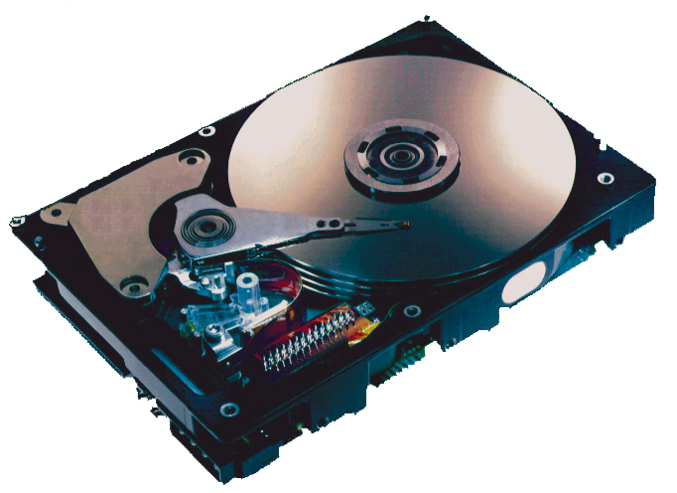
What’s Inside A Disk Drive?
Spindle
Arm
Platters
Actuator
Electronics
(including a
processor
and memory!)
SCSI
connector
Image courtesy of Seagate Technology

Slide 50
Disk Geometry
Disks consist of platters(盘片), each with two surfaces盘面.
Each surface consists of concentric rings called tracks磁道.
Each track consists of sectors扇区 separated by gaps.
Tracks
Surface
Track k
Gaps
Spindle
Sectors

Slide 51
Disk Geometry (Muliple-Platter View)
Aligned tracks form a cylinder.
Cylinder k
Surface 0
Platter 0
Surface 1
Surface 2
Platter 1
Surface 3
Surface 4
Platter 2
Surface 5
Spindle

Slide 52
Disk Capacity
Capacity: maximum number of bits that can be stored.
Capacity is determined by these technology factors:
Recording density (bits/in): number of bits that can be squeezed into a 1 inch segment of a track.
Track density (tracks/in): number of tracks that can be squeezed into a 1 inch radial segment.
Areal density (bits/in2): product of recording and track density.

Slide 53
Disk Capacity
Modern disks partition tracks into disjoint subsets called recording zones
Each track in a zone has the same number of sectors(每个磁道的扇区数量相同), determined by the circumference of innermost track(由最内侧周长决定).
Each zone has a different number of sectors/track

Slide 54
Computing Disk Capacity
Capacity = (# bytes/sector) x (avg. # sectors/track) x
(# tracks/surface) x (# surfaces/platter) x
(# platters/disk)
Example:
512 bytes/sector
300 sectors/track (on average)
20,000 tracks/surface
2 surfaces/platter
5 platters/disk
Capacity = 512 x 300 x 20000 x 2 x 5
= 30,720,000,000
= 30.72 GB

Slide 55
Disk Operation (Single-Platter View)
The disk surface
spins at a fixed
rotational rate
The read/write head
is attached to the end
of the arm and flies over
the disk surface on
a thin cushion of air.
spindle
spindle
spindle
spindle
spindle
By moving radially, the arm can position the read/write head over any track.

Slide 56
Disk Operation (Multi-Platter View)
Read/write heads
move in unison
from cylinder to cylinder
Arm
Spindle（主轴）

Slide 57
Disk Structure - top view of single platter
Surface organized into tracks
Tracks divided into sectors
Notes:
Goal:
Show the inefficeincy of current disk requests.
Conveyed Ideas:
Rotational latency is wasted time that can be used to service tasks
Background Information:
None.
Slide Background:
None.
Kill text and arrows

Slide 58
Disk Access
Head in position above a track
Notes:
Goal:
Show the inefficeincy of current disk requests.
Conveyed Ideas:
Rotational latency is wasted time that can be used to service tasks
Background Information:
None.
Slide Background:
None.
Kill text and arrows

Slide 59
Disk Access
Rotation is counter-clockwise
Notes:
Goal:
Show the inefficeincy of current disk requests.
Conveyed Ideas:
Rotational latency is wasted time that can be used to service tasks
Background Information:
None.
Slide Background:
None.
Kill text and arrows

Slide 60
Disk Access – Read
About to read blue sector
Notes:
Goal:
Show the inefficeincy of current disk requests.
Conveyed Ideas:
Rotational latency is wasted time that can be used to service tasks
Background Information:
None.
Slide Background:
None.
Kill text and arrows

Slide 61
Disk Access – Read
After BLUE read
After reading blue sector
Notes:
Goal:
Show the inefficeincy of current disk requests.
Conveyed Ideas:
Rotational latency is wasted time that can be used to service tasks
Background Information:
None.
Slide Background:
None.
Kill text and arrows

Slide 62
Disk Access – Read
After BLUE read
Red request scheduled next
Notes:
Goal:
Show the inefficeincy of current disk requests.
Conveyed Ideas:
Rotational latency is wasted time that can be used to service tasks
Background Information:
None.
Slide Background:
None.
Kill text and arrows

Slide 63
Disk Access – Seek
After BLUE read
Seek for RED
Seek to red’s track
Notes:
Goal:
Show the inefficeincy of current disk requests.
Conveyed Ideas:
Rotational latency is wasted time that can be used to service tasks
Background Information:
None.
Slide Background:
None.
Kill text and arrows

Slide 64
Disk Access – Rotational Latency
After BLUE read
Seek for RED
Rotational latency
Wait for red sector to rotate around
Notes:
Goal:
Show the inefficeincy of current disk requests.
Conveyed Ideas:
Rotational latency is wasted time that can be used to service tasks
Background Information:
None.
Slide Background:
None.
Kill text and arrows

Slide 65
Disk Access – Read
After BLUE read
Seek for RED
Rotational latency
After RED read
Complete read of red
Notes:
Goal:
Show the inefficeincy of current disk requests.
Conveyed Ideas:
Rotational latency is wasted time that can be used to service tasks
Background Information:
None.
Slide Background:
None.
Kill text and arrows

Slide 66
Disk Access – Service Time Components
After BLUE read
Seek for RED
Rotational latency
After RED read
Data transfer
Seek
Rotational
latency
Data transfer
Notes:
Goal:
Show the inefficeincy of current disk requests.
Conveyed Ideas:
Rotational latency is wasted time that can be used to service tasks
Background Information:
None.
Slide Background:
None.
Kill text and arrows

Slide 67
Disk Access Time
Disks read and write data in sector-sized blocks.
The access time for a sector has three main components: seek time, rotational latency and transfer time
Average time to access some target sector approximated by :
Taccess = Tavg seek + Tavg rotation + Tavg transfer

Slide 68
Disk Access Time
Seek time (Tavg seek)
Time to position heads over cylinder containing target sector.
Typical Tavg seek is 3—9 ms
Rotational latency (Tavg rotation)
Time waiting for first bit of target sector to pass under r/w head.
Tavg rotation = 1/2 x 1/RPMs(Revolutions Perminute转/每分钟 ) x 60 sec/1 min
Typical Tavg rotation = 7200 RPMs
Transfer time (Tavg transfer)
Time to read the bits in the target sector.
Tavg transfer = 1/RPM x 1/(avg # sectors/track) x 60 secs/1 min.

Slide 69
Disk Access Time Example
Given:
Rotational rate = 7,200 RPM
Average seek time = 9 ms.
Avg # sectors/track = 400.
Derived:
Tavg rotation = 1/2 x (60 secs/7200 RPM) x 1000 ms/sec = 4 ms.
Tavg transfer = 60/7200 RPM x 1/400 secs/track x 1000 ms/sec = 0.02 ms
Taccess = 9 ms + 4 ms + 0.02 ms

Slide 70
Disk Access Time Example
Important points:
Access time dominated by seek time and rotational latency.
First bit in a sector is the most expensive, the rest are free.
SRAM access time is about 4 ns/doubleword, DRAM about 60 ns
Disk is about 40,000 times slower than SRAM,
2,500 times slower then DRAM.

Slide 71
Logical Disk Blocks
Modern disks present a simpler abstract view of the complex sector geometry:
The set of available sectors is modeled as a sequence of b-sized logical blocks (0, 1, 2, ...)
Mapping between logical blocks and actual (physical) sectors
Maintained by hardware/firmware device called disk controller.
Converts requests for logical blocks into (surface,track,sector) triples.

Slide 72
I/O Bus
CPU chip
Register file
ALU
System bus
Memory bus
Main
memory
Bus interface
I/O
bridge
I/O bus
Expansion slots for
other devices such
as network adapters.
USB
controller
Graphics
adapter
Disk
controller
Mouse
Keyboard
Monitor
Disk

Slide 73
Reading a Disk Sector (1)
CPU chip
CPU initiates a disk read by writing a command, logical block number, and destination memory address to a port (address) associated with disk controller.
Register file
ALU
Main
memory
Bus interface
I/O bus
USB
controller
Graphics
adapter
Disk
controller
mouse
keyboard
Monitor
Disk

Slide 74
Reading a Disk Sector (2)
CPU chip
Disk controller reads the sector and performs a direct memory access (DMA) transfer into main memory.
Register file
ALU
Main
memory
Bus interface
I/O bus
USB
controller
Graphics
adapter
Disk
controller
Mouse
Keyboard
Monitor
Disk

Slide 75
Reading a Disk Sector (3)
CPU chip
When the DMA transfer completes, the disk controller notifies the CPU with an interrupt (i.e., asserts a special “interrupt” pin on the CPU)
Register file
ALU
Main
memory
Bus interface
I/O bus
USB
controller
Graphics
adapter
Disk
controller
Mouse
Keyboard
Monitor
Disk

Slide 76
Solid State Disk (SSD)
Flash Memory
No rotating equipment
Faster than Disks

Slide 77
Solid State Disks (SSDs)
I/O bus
Requests to read and
write logical disk blocks
Solid State Disk (SSD)
Flash
translation layer
Flash memory
Block 0
Block B-1
…
…
…
Page 0
Page 1
Page P-1
Page 0
Page 1
Page P-1
Pages: 512KB to 4KB, Blocks: 32 to 128 pages
Data read/written in units of pages.
Page can be written only after its block has been erased
A block wears out after 100,000 repeated writes.

Slide 78
SSD Performance Characteristics
Sequential read tput 250 MB/s Sequential write tput 170 MB/s
Random read tput 140 MB/s Random write tput 14 MB/s
Rand read access 30 us Random write access 300 us
Why are random writes so slow?
Erasing a block is slow (around 1 ms)
Write to a page triggers a copy of all useful pages in the block
Find an used block (new block) and erase it
Write the page into the new block
Copy other pages from old block to the new block

Slide 79
SSD Tradeoffs vs Rotating Disks
Advantages
No moving parts → faster, less power, more rugged
Disadvantages
Have the potential to wear out
Mitigated by “wear leveling logic” in flash translation layer(寿命影响)
E.g. Intel X25 guarantees 1 petabyte (1015 bytes) of random writes before they wear out
In 2010, about 100 times more expensive per byte
Applications
MP3 players, smart phones, laptops
Beginning to appear in desktops and servers

Slide 80
Storage Trends

Slide 81
CPU Clock Rates
Inflection point in computer history
when designers hit the “Power Wall”
1980 1990 1995 2000 2003 2005 2010 2010:1980
CPU 8080 386 Pentium P-III P-4 Core 2 Core i7 ---
Clock
rate (MHz) 1 20 150 600 3300 2000 2500 2500
Cycle
time (ns) 1000 50 6 1.6 0.3 0.50 0.4 2500
Cores 1 1 1 1 1 2 4 4
Effective
cycle 1000 50 6 1.6 0.3 0.25 0.1 10,000
time (ns)

Slide 82
The CPU-Memory Gap
The gap widens between DRAM, disk, and CPU speeds.
Disk
SSD
DRAM
CPU

Slide 83
Locality to the Rescue!
The key to bridging this CPU-Memory gap is a fundamental property of computer programs known as locality.

Slide 84
Homework
Practice Problem 6.1-6.4
Review Chapter 6.1

Slide 85
Today
Storage technologies and trends
Locality of reference
Caching in the memory hierarchy

Slide 86
Locality
Principle of Locality: Programs tend to use data and instructions with addresses near or equal to those they have used recently
Temporal locality:
Recently referenced items are likely to be referenced again in the near future
Spatial locality:
Items with nearby addresses tend to be referenced close together in time

Slide 87
Locality Example
sum = 0;
for (i = 0; i < n; i++)
sum += a[i];
return sum;
Data references
Reference array elements in succession (连续) (stride-1 reference pattern).
Reference variable sum each iteration.
Instruction references
Reference instructions in sequence.
Cycle through loop repeatedly.
Spatial locality
Temporal locality
Spatial locality
Temporal locality

Slide 88
Qualitative Estimates of Locality
Claim: Being able to look at code and get a qualitative sense of its locality is a key skill for a professional programmer.
Question: Does this function have good locality with respect to array a?
int sum_array_rows(int a[M][N])
{
int i, j, sum = 0;
for (i = 0; i < M; i++)
for (j = 0; j < N; j++)
sum += a[i][j];
return sum;
}

Slide 89
Locality Example
Question: Does this function have good locality with respect to array a?
int sum_array_cols(int a[M][N])
{
int i, j, sum = 0;
for (j = 0; j < N; j++)
for (i = 0; i < M; i++)
sum += a[i][j];
return sum;
}

Slide 90
Locality Example
Question: Can you permute the loops so that the function scans the 3-d array a with a stride-1 reference pattern (and thus has good spatial locality)?
int sum_array_3d(int a[M][N][N])
{
int i, j, k, sum = 0;
for (i = 0; i < M; i++)
for (j = 0; j < N; j++)
for (k = 0; k < N; k++)
sum += a[k][i][j];
return sum;
}

Slide 91
Memory Hierarchies
Some fundamental and enduring properties of hardware and software:
Fast storage technologies cost more per byte, have less capacity, and require more power (heat!).
The gap between CPU and main memory speed is widening.
Well-written programs tend to exhibit good locality.
These fundamental properties complement each other beautifully.
They suggest an approach for organizing memory and storage systems known as a memory hierarchy.

Slide 92
Today
Storage technologies and trends
Locality of reference
Caching in the memory hierarchy

Slide 93
Storage Structure in Computer
Register
cache
Memory
Disk
CD
ALU
CU
CPU
低

Slide 94
An Example Memory Hierarchy
L0:
CPU registers hold words retrieved from L1 cache
Registers
L1:
L1 cache
(SRAM)
Smaller,
faster,
costlier
per byte
L1 cache holds cache lines retrieved from L2 cache
L2:
L2 cache
(SRAM)
L2 cache holds cache lines retrieved from main memory
L3:
Larger,
slower,
cheaper
per byte
Main memory
(DRAM)
Main memory holds disk blocks retrieved from local disks
L4:
Local secondary storage
(local disks)
Local disks hold files retrieved from disks on remote network servers
Remote secondary storage
(tapes, distributed file systems, Web servers)
L5:

Slide 95
Two layers
Cache——Memory
Speed, Cost gap
Memory——External Memory
Speed, Capacity, Cost
10 ns
20 ns
200 ns
ms
Memory
External Memory
CPU
Cache

Slide 96
Caches
Cache: A smaller, faster storage device that acts as a staging area for a subset of the data in a larger, slower device.
Fundamental idea of a memory hierarchy:
For each k, the faster, smaller device at level k serves as a cache for the larger, slower device at level k+1.
Why do memory hierarchies work?
Because of locality, programs tend to access the data at level k more often than they access the data at level k+1.
Thus, the storage at level k+1 can be slower, and thus larger and cheaper per bit.

Slide 97
Caches
Big Idea: The memory hierarchy creates a large pool of storage that costs as much as the cheap storage near the bottom, but that serves data to programs at the rate of the fast storage near the top.

Slide 98
General Cache Concepts
Smaller, faster, more expensive
memory caches a subset of
the blocks
Cache
8
4
9
14
10
3
Data is copied in block-sized transfer units
4
10
Larger, slower, cheaper memory
viewed as partitioned into “blocks”
Memory
0
1
2
3
4
4
5
6
7
8
9
10
10
11
12
13
14
15

Slide 99
General Cache Concepts: Hit
Request: 14
Data in block b is needed
Block b is in cache:
Hit!
Cache
8
9
14
3
14
Memory
0
1
2
3
4
5
6
7
8
9
10
11
12
13
14
15

Slide 100
General Cache Concepts: Miss
Request: 12
Data in block b is needed
Block b is not in cache:
Miss!
Cache
8
9
14
3
12
Block b is fetched from
memory
12
Request: 12
Block b is stored in cache
Placement policy: determines where b goes
Replacement policy: determines which block gets evicted (victim)
Memory
0
1
2
3
4
5
6
7
8
9
10
11
12
12
13
14
15

Slide 101
General Caching Concepts: Types of Cache Misses
Cold (compulsory) miss
Cold misses occur because the cache is empty.
Conflict miss
Most caches limit blocks at level k+1 to a small subset (sometimes a singleton) of the block positions at level k.
E.g. Block i at level k+1 must be placed in block (i mod 4) at level k.
Conflict misses occur when the level k cache is large enough, but multiple data objects all map to the same level k block.
E.g. Referencing blocks 0, 8, 0, 8, 0, 8, ... would miss every time.
Capacity miss
Occurs when the set of active cache blocks (working set) is larger than the cache.

Slide 102
Examples of Caching in the Hierarchy
Cache Type
What is Cached?
Where is it Cached?
Latency (cycles)
Managed By
Registers
4-8 bytes words
CPU core
0
Compiler
TLB
Address translations
On-Chip TLB
0
Hardware
L1 cache
64-bytes block
On-Chip L1
1
Hardware
L2 cache
64-bytes block
On/Off-Chip L2
10
Hardware
Virtual Memory
4-KB page
Main memory
100
Hardware + OS
Buffer cache
Parts of files
Main memory
100
OS
Disk cache
Disk sectors
Disk controller
100,000
Disk firmware
Network buffer cache
Parts of files
Local disk
10,000,000
AFS/NFS client
Browser cache
Web pages
Local disk
10,000,000
Web browser
Web cache
Web pages
Remote server disks
1,000,000,000
Web proxy server

Slide 103
Summary
The speed gap between CPU, memory and mass storage continues to widen.
Well-written programs exhibit a property called locality.
Memory hierarchies based on caching close the gap by exploiting locality.

Slide 104
6.2 Cache
Cache memory organization and operation
Performance impact of caches
The memory mountain
Rearranging loops to improve spatial locality
Using blocking to improve temporal locality

Slide 105
Cache Memories
Cache memories are small, fast SRAM-based memories managed automatically in hardware.
Hold frequently accessed blocks of main memory
CPU looks first for data in caches (e.g., L1, L2, and L3), then in main memory.
Typical system structure:
CPU chip
Register file
ALU
Cache
memories
System bus
Memory bus
Main
memory
Bus interface
I/O
bridge

Slide 106
General Cache Organization (S, E, B)
E = 2e lines per set
set
line
S = 2^{s} sets
Cache size:
C = S x E x B data bytes
v
tag
0
1
2
B-1
valid bit
B = 2^{b} bytes per cache block (the data)

Slide 107
Cache Read
Locate set
Check if any line in set has matching tag
Yes + line valid: hit
Locate data starting at offset
E = 2e lines per set
Address of word:
t bits
s bits
b bits
S = 2^{s} sets
tag
set
index
block
offset
data begins at this offset
v
tag
0
1
2
B-1
valid bit
B = 2^{b} bytes per cache block (the data)

Slide 108
Example: Direct Mapped Cache (E = 1)
Direct mapped: One line per set
Assume: cache block size 8 bytes
Address of int:
v
tag
0
1
2
3
4
5
6
7
t bits
0…01
100
v
tag
0
1
2
3
4
5
6
7
find set
S = 2^{s} sets
v
tag
0
1
2
3
4
5
6
7
v
tag
0
1
2
3
4
5
6
7

Slide 109
Example: Direct Mapped Cache (E = 1)
Direct mapped: One line per set
Assume: cache block size 8 bytes
Address of int:
valid? +
match: assume yes = hit
t bits
0…01
100
v
tag
0
1
2
3
4
5
6
7
tag
block offset

Slide 110
Example: Direct Mapped Cache (E = 1)
Direct mapped: One line per set
Assume: cache block size 8 bytes
Address of int:
valid? +
match: assume yes = hit
t bits
0…01
100
v
tag
0
1
2
3
4
5
6
7
block offset
int (4 Bytes) is here
No match: old line is evicted and replaced

Slide 111
Direct-Mapped Cache Simulation
t=1
s=2
b=1
M=16 byte addresses, B=2 bytes/block,
S=4 sets, E=1 Blocks/set
Address trace (reads, one byte per read):
0 [0000₂],
1 [0001₂],
7 [0111₂],
8 [1000₂],
0 [0000₂]
x
xx
x
miss
hit
miss
miss
miss
v
Tag
Block
Set 0
0
?
?
1
1
1
0
1
0
M[0-1]
M[8-9]
M[0-1]
Set 1
Set 2
Set 3
1
0
M[6-7]

Slide 112
A Higher Level Example
Ignore the variables sum, i, j
assume: cold (empty) cache,
a[0][0] goes here
int sum_array_rows(double a[16][16])
{
int i, j;
double sum = 0;
for (i = 0; i < 16; i++)
for (j = 0; j < 16; j++)
sum += a[i][j];
return sum;
}
int sum_array_cols(double a[16][16])
{
int i, j;
double sum = 0;
for (j = 0; j < 16; j++)
for (i = 0; i < 16; i++)
sum += a[i][j];
return sum;
}
32 B = 4 doubles
blackboard

Slide 113
E-way Set Associative Cache (Here: E = 2)
E = 2: Two lines per set
Assume: cache block size 8 bytes
Address of short int:
t bits
0…01
100
v
tag
0
1
2
3
4
5
6
7
v
tag
0
1
2
3
4
5
6
7
v
tag
0
1
2
3
4
5
6
7
v
tag
0
1
2
3
4
5
6
7
find set
v
tag
0
1
2
3
4
5
6
7
v
tag
0
1
2
3
4
5
6
7
v
tag
0
1
2
3
4
5
6
7
v
tag
0
1
2
3
4
5
6
7

Slide 114
E-way Set Associative Cache (Here: E = 2)
E = 2: Two lines per set
Assume: cache block size 8 bytes
Address of short int:
compare both
t bits
0…01
100
valid? +
match: yes = hit
v
tag
0
1
2
3
4
5
6
7
tag
v
tag
0
1
2
3
4
5
6
7
block offset

Slide 115
E-way Set Associative Cache (Here: E = 2)
E = 2: Two lines per set
Assume: cache block size 8 bytes
Address of short int:
compare both
t bits
0…01
100
valid? +
match: yes = hit
v
tag
0
1
2
3
4
5
6
7
v
tag
0
1
2
3
4
5
6
7
block offset
short int (2 Bytes) is here
No match:
One line in set is selected for eviction and replacement
Replacement policies: random, least recently used (LRU), …

Slide 116
2-Way Set Associative Cache Simulation
t=2
s=1
b=1
xx
x
x
M=16 byte addresses, B=2 bytes/block,
S=2 sets, E=2 blocks/set
Address trace (reads, one byte per read):
0 [0000₂],
1 [0001₂],
7 [0111₂],
8 [1000₂],
0 [0000₂]
miss
hit
miss
miss
hit
v
Tag
Block
0
?
?
Set 0
1
00
M[0-1]
1
10
M[8-9]
0
1
01
M[6-7]
Set 1
0
0

Slide 117
A Higher Level Example
Ignore the variables sum, i, j
assume: cold (empty) cache,
a[0][0] goes here
int sum_array_rows(double a[16][16])
{
int i, j;
double sum = 0;
for (i = 0; i < 16; i++)
for (j = 0; j < 16; j++)
sum += a[i][j];
return sum;
}
32 B = 4 doubles
int sum_array_cols(double a[16][16])
{
int i, j;
double sum = 0;
for (j = 0; j < 16; j++)
for (i = 0; i < 16; i++)
sum += a[i][j];
return sum;
}
blackboard

Slide 118
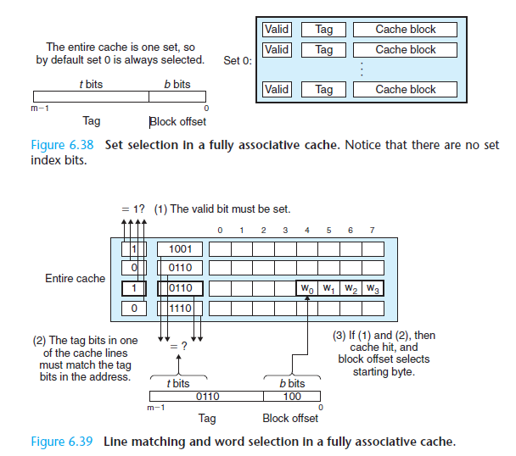
Full Associative Caches

Slide 119
Advantages & Disadvantages
Direct Mapped Cache
Set Associative Cache
Full Associative Caches

Slide 120
What about writes?
Multiple copies of data exist:
L1, L2, Main Memory, Disk
What to do on a write-hit?
Write-through (write immediately to memory)
Write-back (defer write to memory until replacement of line)
Need a dirty bit (line different from memory or not)
What to do on a write-miss?
Write-allocate (load into cache, update line in cache)
Good if more writes to the location follow
No-write-allocate (writes immediately to memory)
Typical
Write-through + No-write-allocate
Write-back + Write-allocate

Slide 121
Intel Core i7 Cache Hierarchy
Processor package
Core 0
Core 3
L1 i-cache and d-cache:
32 KB, 8-way,
Access: 4 cycles
L2 unified cache:
256 KB, 8-way,
Access: 11 cycles
L3 unified cache:
8 MB, 16-way,
Access: 30-40 cycles
Block size: 64 bytes for all caches.
Regs
Regs
L1
d-cache
L1
i-cache
L1
d-cache
L1
i-cache
…
L2 unified cache
L2 unified cache
L3 unified cache
(shared by all cores)
Main memory

Slide 122
Cache Performance Metrics
Miss Rate
Fraction of memory references not found in cache (misses / accesses) = 1 – hit rate
Typical numbers (in percentages):
3-10% for L1
can be quite small (e.g., < 1%) for L2, depending on size, etc.

Slide 123
Cache Performance Metrics
Hit Time
Time to deliver a line in the cache to the processor
includes time to determine whether the line is in the cache
Typical numbers:
1-2 clock cycle for L1
5-20 clock cycles for L2
Miss Penalty
Additional time required because of a miss
typically 50-200 cycles for main memory (Trend: increasing!)

Slide 124
Let‘s think about those numbers
Huge difference between a hit and a miss
Could be 100x, if just L1 and main memory
Would you believe 99% hits is twice as good as 97%?
Consider: cache hit time of 1 cycle miss penalty of 100 cycles
Average access time:
97% hits: 1 cycle + 0.03 * 100 cycles = 4 cycles
99% hits: 1 cycle + 0.01 * 100 cycles = 2 cycles
This is why “miss rate” is used instead of “hit rate”

Slide 125
Writing Cache Friendly Code
Make the common case go fast
Focus on the inner loops of the core functions
Minimize the misses in the inner loops
Repeated references to variables are good (temporal locality)
Stride-1 reference patterns are good (spatial locality)
Key idea: Our qualitative notion of locality is quantified through our understanding of cache memories.

Slide 126
6.2 Cache
Cache organization and operation
Performance impact of caches
The memory mountain
Rearranging loops to improve spatial locality
Using blocking to improve temporal locality

Slide 127
The Memory Mountain
Read throughput (read bandwidth)
Number of bytes read from memory per second (MB/s)
Memory mountain: Measured read throughput as a function of spatial and temporal locality.
Compact way to characterize memory system performance.

Slide 128
Memory Mountain Test Function
/* The test function */
void test(int elems, int stride) {
int i, result = 0;
volatile int sink;
for (i = 0; i < elems; i += stride)
result += data[i];
sink = result; /* So compiler doesn't optimize away the loop */
}
/* Run test(elems, stride) and return read throughput (MB/s) */
double run(int size, int stride, double Mhz)
{
double cycles;
int elems = size / sizeof(int);
test(elems, stride); /* warm up the cache */
cycles = fcyc2(test, elems, stride, 0); /* call test(elems,stride) */
return (size / stride) / (cycles / Mhz); /* convert cycles to MB/s */
}

Slide 129
The Memory Mountain
Intel Core i7
32 KB L1 i-cache
32 KB L1 d-cache
256 KB unified L2 cache
8M unified L3 cache
All caches on-chip

Slide 130
The Memory Mountain
Intel Core i7
32 KB L1 i-cache
32 KB L1 d-cache
256 KB unified L2 cache
8M unified L3 cache
All caches on-chip
Slopes 斜坡 of
spatial
locality

Slide 131
The Memory Mountain
Intel Core i7
32 KB L1 i-cache
32 KB L1 d-cache
256 KB unified L2 cache
8M unified L3 cache
All caches on-chip
Ridges 山脊 of
Temporal
locality
Slopes of
spatial
locality

Slide 132
6.2 Cache
Cache organization and operation
Performance impact of caches
The memory mountain
Rearranging loops to improve spatial locality
Using blocking to improve temporal locality

Slide 133
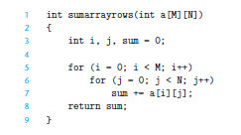

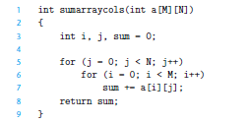

An Case Study

Slide 134
Discussion
How do you define the “locality” ?
How to tune your program ?
How does the locality affect our caches?

Slide 135
Miss Rate Analysis for Matrix Multiply
Assume:
Line size = 32B (big enough for four 64-bit words)
Matrix dimension (N) is very large
Approximate 1/N as 0.0
Cache is not even big enough to hold multiple rows
Analysis Method:
Look at access pattern of inner loop
k
j
j
i
k
i
A
B
C

Slide 136
Matrix Multiplication Example
Description:
Multiply N x N matrices
O(N³) total operations
N reads per source element
N values summed per destination
but may be able to hold in register
Variable sum
held in register
/* ijk */
for (i=0; i<n; i++) {
for (j=0; j<n; j++) {
sum = 0.0;
for (k=0; k<n; k++)
sum += a[i][k] * b[k][j];
c[i][j] = sum;
}
}

Slide 137
Layout of C Arrays in Memory (review)
C arrays allocated in row-major order
each row in contiguous memory locations
Stepping through columns in one row:
for (i = 0; i < N; i++)
sum += a[0][i];
accesses successive elements
Stepping through rows in one column:
for (i = 0; i < n; i++)
sum += a[i][0];
accesses distant elements
no spatial locality!

Slide 138
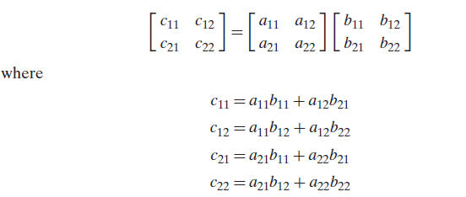
Rearranging loops

Slide 139
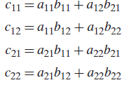
Three kinds of Matrix Multiplication
for (i=0; i<n; i++) {
for (j=0; j<n; j++) {
sum = 0.0;
for (k=0; k<n; k++)
sum += a[i][k] * b[k][j];
c[i][j] = sum;
}
}
for (k=0; k<n; k++) {
for (i=0; i<n; i++) {
r = a[i][k];
for (j=0; j<n; j++)
c[i][j] += r * b[k][j];
}
}
for (j=0; j<n; j++) {
for (k=0; k<n; k++) {
r = b[k][j];
for (i=0; i<n; i++)
c[i][j] += a[i][k] * r;
}
}

Slide 140
Which is the fastest ? Why ?
Guess ?
ijk
ikj
kij
kji
jki
jik

Slide 141
Matrix Multiplication (ijk)
/* ijk */
for (i=0; i<n; i++) {
for (j=0; j<n; j++) {
sum = 0.0;
for (k=0; k<n; k++)
sum += a[i][k] * b[k][j];
c[i][j] = sum;
}
}
Inner loop:
(*,j)
(i,j)
(i,*)
A
B
C
Row-wise
Column-
wise
Fixed
Misses per inner loop iteration:
A B C
0.25 1.0 0.0

Slide 142
Matrix Multiplication (jik)
/* jik */
for (j=0; j<n; j++) {
for (i=0; i<n; i++) {
sum = 0.0;
for (k=0; k<n; k++)
sum += a[i][k] * b[k][j];
c[i][j] = sum
}
}
Inner loop:
(*,j)
(i,j)
(i,*)
A
B
C
Row-wise
Column-
wise
Fixed
Misses per inner loop iteration:
A B C
0.25 1.0 0.0

Slide 143
Matrix Multiplication (kij)
/* kij */
for (k=0; k<n; k++) {
for (i=0; i<n; i++) {
r = a[i][k];
for (j=0; j<n; j++)
c[i][j] += r * b[k][j];
}
}
Inner loop:
(i,k)
(k,*)
(i,*)
A
B
C
Fixed
Row-wise
Row-wise
Misses per inner loop iteration:
A B C
0.0 0.25 0.25

Slide 144
Matrix Multiplication (ikj)
/* ikj */
for (i=0; i<n; i++) {
for (k=0; k<n; k++) {
r = a[i][k];
for (j=0; j<n; j++)
c[i][j] += r * b[k][j];
}
}
Inner loop:
(i,k)
(k,*)
(i,*)
A
B
C
Fixed
Row-wise
Row-wise
Misses per inner loop iteration:
A B C
0.0 0.25 0.25

Slide 145
Matrix Multiplication (jki)
Inner loop:
/* jki */
for (j=0; j<n; j++) {
for (k=0; k<n; k++) {
r = b[k][j];
for (i=0; i<n; i++)
c[i][j] += a[i][k] * r;
}
}
(*,k)
(*,j)
(k,j)
A
B
C
Column-
wise
Fixed
Column-
wise
Misses per inner loop iteration:
A B C
1.0 0.0 1.0

Slide 146
Matrix Multiplication (kji)
/* kji */
for (k=0; k<n; k++) {
for (j=0; j<n; j++) {
r = b[k][j];
for (i=0; i<n; i++)
c[i][j] += a[i][k] * r;
}
}
Inner loop:
(*,k)
(*,j)
(k,j)
A
B
C
Column-
wise
Fixed
Column-
wise
Misses per inner loop iteration:
A B C
1.0 0.0 1.0

Slide 147
Core i7 Matrix Multiply Performance
jki / kji
ijk / jik
kij / ikj

Slide 148
Concluding Observations
Programmer can optimize for cache performance
How data structures are organized
How data are accessed
Nested loop structure
Blocking is a general technique
All systems favor “cache friendly code”
Getting absolute optimum performance is very platform specific
Cache sizes, line sizes, associativities, etc.
Can get most of the advantage with generic code
Keep working set reasonably small (temporal locality)
Use small strides (spatial locality)

Slide 149
6.3 Virtual Memory
Address spaces
VM as a tool for caching
VM as a tool for memory management
VM as a tool for memory protection
Address translation

Slide 150
A System Using Physical Addressing
Main memory
0:
1:
Physical address
(PA)
2:
CPU
3:
4
4:
5:
6:
7:
8:
...
M-1:
Data word
Used in “simple” systems like embedded microcontrollers in devices like cars, elevators, and digital picture frames

Slide 151
A System Using Virtual Addressing
Main memory
0:
CPU Chip
1:
Virtual address
(VA)
Physical address
(PA)
2:
CPU
MMU
3:
4
4:
4100
5:
6:
7:
8:
...
M-1:
Data word
Used in all modern servers, desktops, and laptops
One of the great ideas in computer science

Slide 152
Address Spaces
Linear address space: Ordered set of contiguous non-negative integer addresses: {0, 1, 2, 3 … }
Virtual address space: Set of N = 2^{n} virtual addresses {0, 1, 2, 3, …, N-1}
Physical address space: Set of M = 2^{m} physical addresses {0, 1, 2, 3, …, M-1}

Slide 153
Why Virtual Memory (VM)?
Uses main memory efficiently
Use DRAM as a cache for the parts of a virtual address space
Simplifies memory management
Each process gets the same uniform linear address space
Isolates address spaces
One process can’t interfere with another’s memory
User program cannot access privileged kernel information (Really ?? Think over an example that you can be a hacker)

Slide 154
Today
Address spaces
VM as a tool for caching
VM as a tool for memory management
Address translation

Slide 155
VM as a Tool for Caching
Virtual memory is an array of N contiguous bytes stored on disk.
The contents of the array on disk are cached in physical memory (DRAM cache)
These cache blocks are called pages (size is P = 2^{p} bytes)
Virtual memory
Physical memory
VP 0
Unallocated
0
VP 1
Cached
0
Empty
PP 0
Uncached
PP 1
Unallocated
Empty
Cached
Uncached
Empty
Cached
M-1
PP 2^{m-p}-1
VP 2^{n-p}-1
Uncached
N-1
Virtual pages (VPs)
stored on disk
Physical pages (PPs)
cached in DRAM

Slide 156
DRAM Cache Organization
DRAM cache organization driven by the enormous miss penalty
DRAM is about 10x slower than SRAM
Disk is about 10,000x slower than DRAM
Consequences
Large page (block) size: typically 4-8 KB, sometimes 4 MB
Fully associative
Any VP can be placed in any PP
Requires a “large” mapping function – different from CPU caches
Highly sophisticated, expensive replacement algorithms
Too complicated and open-ended to be implemented in hardware

Slide 157
Page Tables
A page table is an array of page table entries (PTEs) that maps virtual pages to physical pages.
Per-process kernel data structure in DRAM
Physical memory
(DRAM)
Physical page
number or
disk address
Valid
VP 1
PP 0
PTE 0
0
null
VP 2
1
VP 7
VP 4
PP 3
1
0
1
0
null
Virtual memory
(disk)
0
PTE 7
1
VP 1
Memory resident
page table
(DRAM)
VP 2
VP 3
VP 4
VP 6
VP 7

Slide 158
Page Hit
Page hit: reference to VM word that is in physical memory (DRAM cache hit)
Physical memory
(DRAM)
Physical page
number or
disk address
Virtual address
Valid
VP 1
PP 0
PTE 0
0
null
VP 2
1
VP 7
VP 4
PP 3
1
0
1
0
null
Virtual memory
(disk)
0
PTE 7
1
VP 1
Memory resident
page table
(DRAM)
VP 2
VP 3
VP 4
VP 6
VP 7

Slide 159
Page Fault
Page fault: reference to VM word that is not in physical memory (DRAM cache miss)
Physical memory
(DRAM)
Physical page
number or
disk address
Virtual address
Valid
VP 1
PP 0
PTE 0
0
null
VP 2
1
VP 7
VP 4
PP 3
1
0
1
0
null
Virtual memory
(disk)
0
PTE 7
1
VP 1
Memory resident
page table
(DRAM)
VP 2
VP 3
VP 4
VP 6
VP 7

Slide 160
Handling Page Fault
Page miss causes page fault (an exception)
Physical memory
(DRAM)
Physical page
number or
disk address
Virtual address
Valid
VP 1
PP 0
PTE 0
0
null
VP 2
1
VP 7
VP 4
PP 3
1
0
1
0
null
Virtual memory
(disk)
0
PTE 7
1
VP 1
Memory resident
page table
(DRAM)
VP 2
VP 3
VP 4
VP 6
VP 7

Slide 161
Handling Page Fault
Page miss causes page fault (an exception)
Page fault handler selects a victim to be evicted (here VP 4)
Physical memory
(DRAM)
Physical page
number or
disk address
Virtual address
Valid
VP 1
PP 0
PTE 0
0
null
VP 2
1
VP 7
VP 4
PP 3
1
0
1
0
null
Virtual memory
(disk)
0
PTE 7
1
VP 1
Memory resident
page table
(DRAM)
VP 2
VP 3
VP 4
VP 6
VP 7

Slide 162
Handling Page Fault
Page miss causes page fault (an exception)
Page fault handler selects a victim to be evicted (here VP 4)
Physical memory
(DRAM)
Physical page
number or
disk address
Virtual address
Valid
VP 1
PP 0
PTE 0
0
null
VP 2
1
VP 7
VP 3
PP 3
1
1
0
0
null
Virtual memory
(disk)
0
PTE 7
1
VP 1
Memory resident
page table
(DRAM)
VP 2
VP 3
VP 4
VP 6
VP 7

Slide 163
Handling Page Fault
Page miss causes page fault (an exception)
Page fault handler selects a victim to be evicted (here VP 4)
Offending instruction is restarted: page hit!
Physical memory
(DRAM)
Physical page
number or
disk address
Virtual address
Valid
VP 1
PP 0
PTE 0
0
null
VP 2
1
VP 7
VP 3
PP 3
1
1
0
0
null
Virtual memory
(disk)
0
PTE 7
1
VP 1
Memory resident
page table
(DRAM)
VP 2
VP 3
VP 4
VP 6
VP 7

Slide 164
Locality to the Rescue Again!
Virtual memory works because of locality
At any point in time, programs tend to access a set of active virtual pages called the working set
Programs with better temporal locality will have smaller working sets
If (working set size < main memory size)
Good performance for one process after compulsory misses
If ( SUM(working set sizes) > main memory size )
Thrashing: Performance meltdown where pages are swapped (copied) in and out continuously

Slide 165
Today
Address spaces
VM as a tool for caching
VM as a tool for memory management
VM as a tool for memory protection
Address translation

Slide 166
VM as a Tool for Memory Management
Key idea: each process has its own virtual address space
It can view memory as a simple linear array
Mapping function scatters addresses through physical memory
Well chosen mappings simplify memory allocation and management
0
Address
translation
0
Virtual Address Space for Process 1:
Physical
Address
Space (DRAM)
VP 1
VP 2
PP 2
...
N-1
PP 6
(e.g., read-only
library code)
Virtual Address Space for Process 2:
0
PP 8
VP 1
VP 2
...
...
N-1
M-1

Slide 167
VM as a Tool for Memory Management
Memory allocation
Each virtual page can be mapped to any physical page
A virtual page can be stored in different physical pages at different times
Sharing code and data among processes
Map virtual pages to the same physical page (here: PP 6)
0
Address
translation
0
Virtual Address Space for Process 1:
Physical
Address
Space (DRAM)
VP 1
VP 2
PP 2
...
N-1
PP 6
(e.g., read-only
library code)
Virtual Address Space for Process 2:
0
PP 8
VP 1
VP 2
...
...
N-1
M-1

Slide 168
Today
Address spaces
VM as a tool for caching
VM as a tool for memory management
VM as a tool for memory protection
Address translation

Slide 169
VM Address Translation
Virtual Address Space
V = {0, 1, …, N–1}
Physical Address Space
P = {0, 1, …, M–1}
Address Translation
MAP: V → P U {∅}
For virtual address a:
MAP(a) = a’ if data at virtual address a is at physical address a’ in P
MAP(a) = ∅ if data at virtual address a is not in physical memory
Either invalid or stored on disk

Slide 170
Summary of Address Translation Symbols
Basic Parameters
N = 2^{n} : Number of addresses in virtual address space
M = 2^{m} : Number of addresses in physical address space
P = 2^{p} : Page size (bytes)
Components of the virtual address (VA)
TLBI: TLB index
TLBT: TLB tag
VPO: Virtual page offset
VPN: Virtual page number
Components of the physical address (PA)
PPO: Physical page offset (same as VPO)
PPN: Physical page number
CO: Byte offset within cache line
CI: Cache index
CT: Cache tag

Slide 171
Address Translation With a Page Table
Virtual address
Page table base register
(PTBR)
n-1
p
p-1
0
Virtual page number (VPN)
Virtual page offset (VPO)
Page table address
for process
Page table
Valid
Physical page number (PPN)
Valid bit = 0:
page not in memory
(page fault)
m-1
p
p-1
0
Physical page number (PPN)
Physical page offset (PPO)
Physical address

Slide 172
Address Translation: Page Hit
CPU Chip
2
Cache/
Memory
MMU
PTEA
1
PTE
CPU
VA
3
PA
4
Data
5
1) Processor sends virtual address to MMU
2-3) MMU fetches PTE from page table in memory
4) MMU sends physical address to cache/memory
5) Cache/memory sends data word to processor

Slide 173
Address Translation: Page Fault
Exception
Page fault handler
4
CPU Chip
2
Cache/
Memory
Disk
MMU
PTEA
Victim page
1
5
CPU
VA
PTE
7
3
New page
6
1) Processor sends virtual address to MMU
2-3) MMU fetches PTE from page table in memory
4) Valid bit is zero, so MMU triggers page fault exception
5) Handler identifies victim (and, if dirty, pages it out to disk ? Otherwise )
6) Handler pages in new page and updates PTE in memory
7) Handler returns to original process, restarting faulting instruction

Slide 174
Integrating VM and Cache
PTE
CPU Chip
PTE
MMU
PTEA
hit
Memory
PTEA
PTEA
miss
PTEA
CPU
VA
PA
PA
PA
miss
PA
hit
Data
L1
cache
Data
VA: virtual address, PA: physical address, PTE: page table entry, PTEA = PTE address

Slide 175
Speeding up Translation with a TLB
Page table entries (PTEs) are cached in L1 like any other memory word
PTEs may be evicted by other data references
PTE hit still requires a small L1 delay
Solution: Translation Lookaside Buffer (TLB)
Small hardware cache in MMU
Maps virtual page numbers to physical page numbers
Contains complete page table entries for small number of pages

Slide 176
TLB Hit
CPU Chip
TLB
2
PTE
VPN
3
Cache/
Memory
1
MMU
CPU
VA
PA
4
Data
5
A TLB hit eliminates a memory access

Slide 177
TLB Miss
CPU Chip
TLB
4
2
PTE
VPN
Cache/
Memory
1
MMU
3
CPU
VA
PTEA
PA
5
Data
6
A TLB miss incurs an additional memory access (the PTE) Fortunately, TLB misses are rare. Why?

Slide 178
Summary
Programmer’s view of virtual memory
Each process has its own private linear address space
Cannot be corrupted by other processes
System view of virtual memory
Uses memory efficiently by caching virtual memory pages
Efficient only because of locality
Simplifies memory management and programming

Slide 179
Memory Summary
Memory Hierarchy
DRAM
Disk
Cache
Direct Mapped Cache
Set Mapped Cache
Virtual Memory
MMU

Slide 180
Relationship
L0:
CPU registers hold words retrieved from L1 cache
Registers
L1:
L1 cache
(SRAM)
Smaller,
faster,
costlier
per byte
L1 cache holds cache lines retrieved from L2 cache
L2:
L2 cache
(SRAM)
L2 cache holds cache lines retrieved from main memory
L3:
Larger,
slower,
cheaper
per byte
Main memory
(DRAM)
Main memory holds disk blocks retrieved from local disks
L4:
Local secondary storage
(local disks)
Local disks hold files retrieved from disks on remote network servers
Remote secondary storage
(tapes, distributed file systems, Web servers)
L5:

Slide 181
Group Homework(1~2 people)
Suppose you are playing a computer game (e.g. Warcraft, StarCraft, FiFa 2015 …), use all you have learnt to explain the data transforming & processing process. You should try to write down all the details you think that is essential for you to play games.

Slide 182
Group Homework(1~2 people)
The followings should be covered.
Storage: Disk or SSD, Main Memory, Virtual Memory, Cache, Register.
Processor: Instructions, Register Files, Pipeline, ALU
Print & Submit this homework on the last lesson (Dec. 16th)

Slide 183
Homework
Review Chapter 6, Chapter 9
Practice Problem 9.1-9.3
Practice Problem 6.1-6.14
Submit this homework on the last lesson (Dec. 16th)
Preview COMPUTER RGANIZATION AND ARCHITECTURE DESIGNING FOR PERFORMANCE Chapter 7

Slide 184
Thank You

